Slide 1
Deep Dive in Customer Lifecycle
Xue Bai, Liancheng Gong(Krystal), Tianyu Zhang(Tina)
Instructor: Li Guo, Hongyi Wen, Xinyi Gong

Slide 2
Our goal and Roadmap
Phase 3
Phase 2
Phase 1
Recommend personalize products or services to different customers stages or segments
Design a customer Lifecycle and assign customers (mainly high value customers) into different stages
Calculate customer values according to their personal information, purchase power, and consumption habit

Slide 3
Table of Contents
01
Data Preprocessing
02
Value Classification
03
04
Conclusion &
Future Work
Stage Segment

Slide 4
01
Data Preprocessing

Slide 5
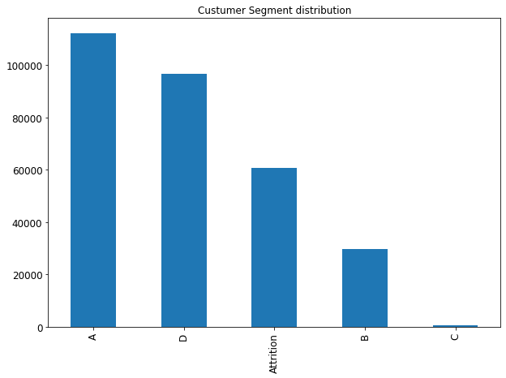
Unbalanced data
X-axis: Customer Segment
Y-axis: Amount of Customer in each segment
· We have much more Non Attrition customers than Attrition customers.
· But we keep all the data even though it is unbalanced, since the real world distribution rule is like this.

Slide 6
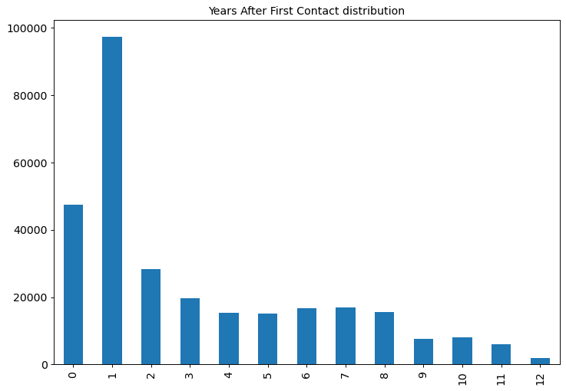
Years After First Contact (开户时间)
X-axis: Years after first contact
Y-axis: Amount of Customer in each segment
· This can represent the racency, which is significant in the following segment
· There are almost no customer life-time longer than 12 years.

Slide 7
Merge Data
Number of Customers that purchased products: 28636
VS
Number of Customers that has Credit Card transactions: 83578
So, we merged the customer info table and Credit Card table, with selected features
Notes:
Among 300039 customers, only 28636, less than 10% of the customer purchased. This group of customers is too niche and it would be easy to get biased result and error using small sample size

Slide 8
Merge Data
Credit Card Feature Engineering
We used Trans_Group feature in the credit card transaction table to segment consumption habit and preference:
Spending 消费
Repayment 还款
Interest 还款利息
Others 其他

Slide 9
02
Customer
Value
Classification

Slide 10
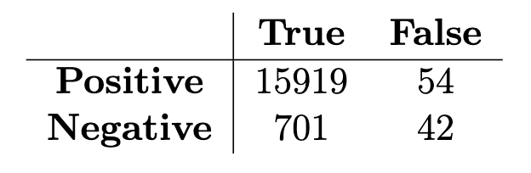
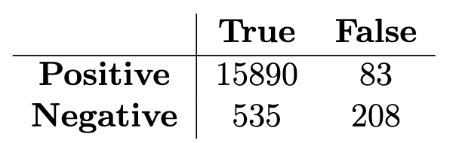
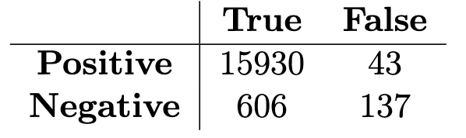
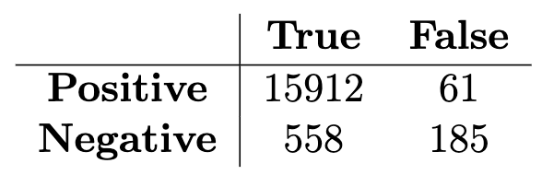
4 Binary Classification Models
Logistic Regression
Random Forest
Decision Tree
XGBoost

Slide 11
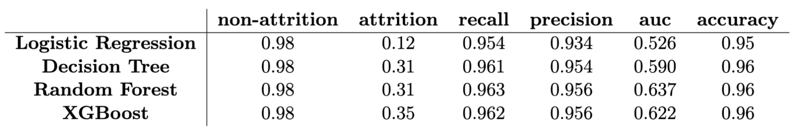
Binary Classification Models
Logistic Regression
Random Forest
Decision Tree
XGBoost
Imbalanced data but high accuracy

Slide 12
Feature importance
Personal Information
Customer age
Phone banking status
Years After
First Contact
Credit Card
Information
Spending amount
Repayment
amount
Credit card transactions
Product Information
Yes
No
Notes:
需要介绍特征吗

Slide 13
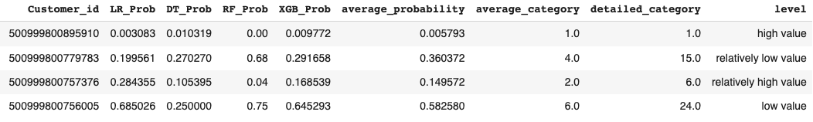
Probability Categorizing
10 categories according to percentile
Take the average
Average_probability is used to categorize and cluster into value levels from k-means
Average_category is used to find the regularity of the relationship between categories and other information

Slide 14
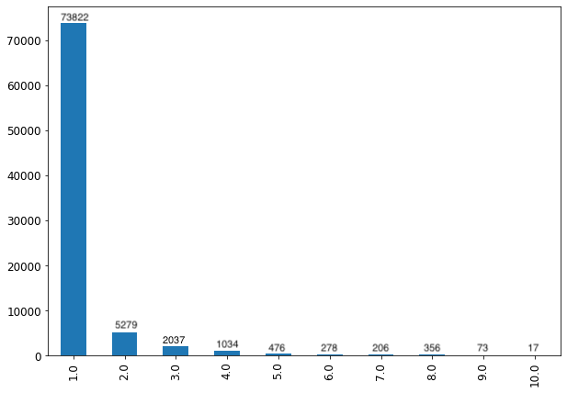
Predict category distribution
Around 88% customers are assigned into category 1. A few customers are category 2 and 3.
Keep that imbalance respect for the real cases.
Number of customers
categories

Slide 15
Probability Categorizing
K-means into 4 levels
40 categories according to percentile
Average_probability is used to categorize and cluster into value levels from k-means
Average_category is used to find the regularity of the relationship between categories and other information
Detailed_category provides more details in the previous analysis
Level is used to classify customers according to their relative values

Slide 16
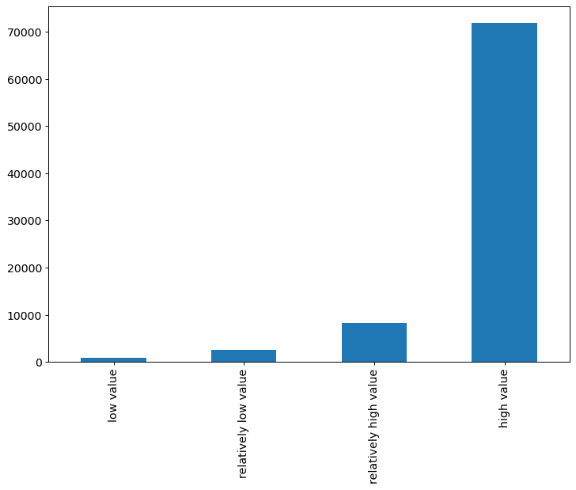
Level distribution
Customers are clustered into four levels based on their average probability by k-means. There are more high value customers than other customers.
Center for each level:
Low: 0.015
Relatively low: 0.139
Relatively high: 0.331
High: 0.683
72515
7777
871
2415
Next step:
Group by predicted categories and take the mean value for each category to find the trend of specific features
Notes:
需要介绍特征吗

Slide 17
Feature importance
Personal Information
Personal Information
Customer age
Customer age
Phone banking status
Phone banking status
Years After
First Contact
Years After
First Contact
Credit Card
Information
Spending amount
Repayment
amount
Credit card transactions
Product Information
Yes
No
Notes:
需要介绍特征吗

Slide 18
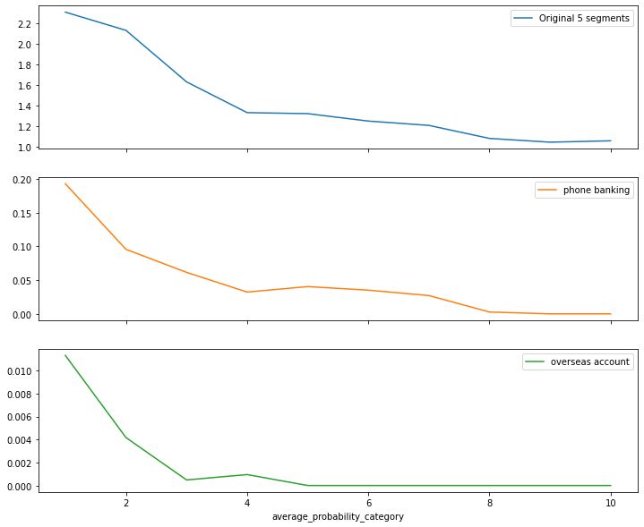
Personal Information
Verification
Average value of each category
The blue line shows that category prediction satisfies original HSBC classification
The orange and green line show that phone banking and overseas account decrease with a higher attrition category
Low attrition category
High attrition category
Notes:
需要介绍特征吗

Slide 19
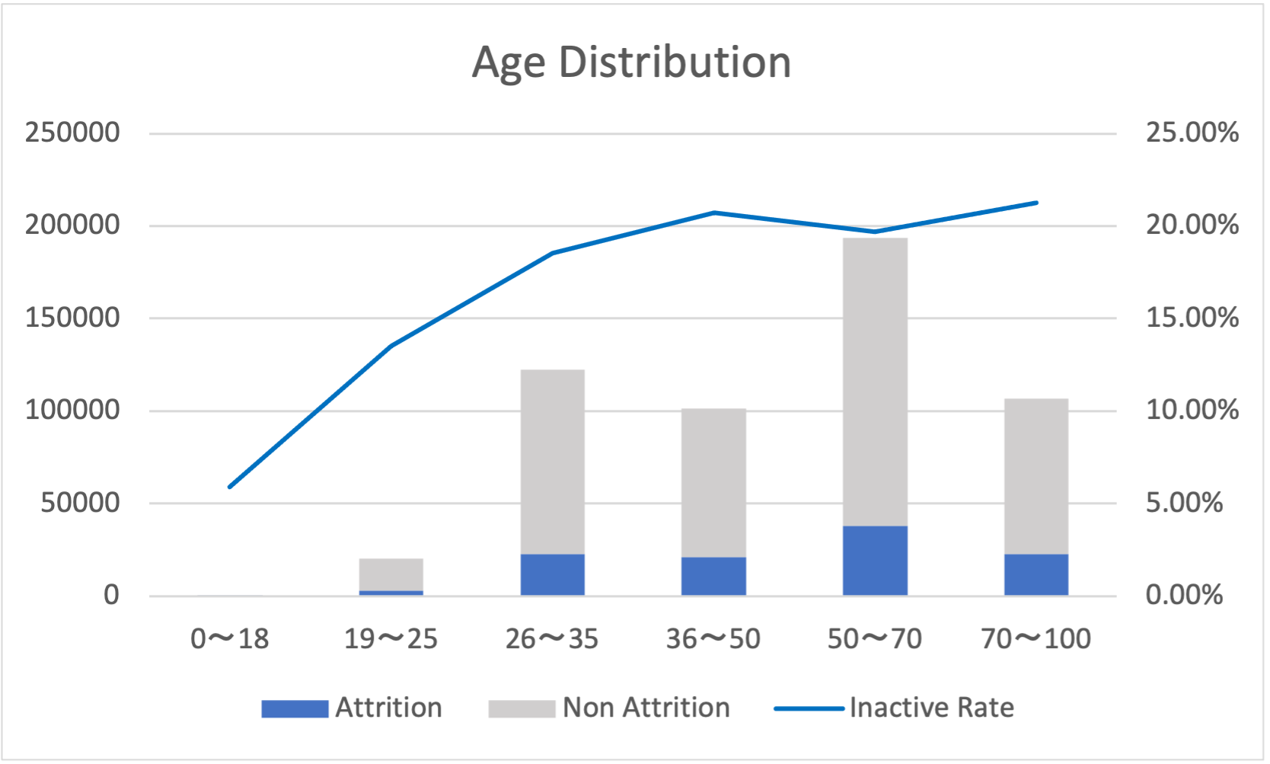
Personal Info
Age
X-axis: Age group
Y-axis: the amount of group people / Inactive Rate
The age of most of the customers is in the range of 26 to 50
Age is positively correlated with the attrition probability
Notes:
需要介绍特征吗

Slide 20
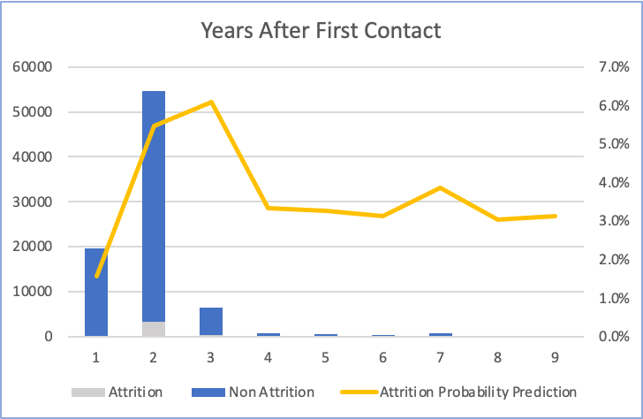
Personal Info
Years After First Contact
More than 50000 customers have opened the account for two years. Those with 2 to 3 years account have the highest attrition probability.
Notes:
需要介绍特征吗

Slide 21
Feature importance
Personal Information
Customer age
Phone banking status
Years After
First Contact
Credit Card
Information
Credit Card
Information
Spending amount
Spending amount
Repayment
amount
Repayment
amount
Credit card transactions
Credit card transactions
Product Information
Yes
No
Notes:
需要介绍特征吗

Slide 22
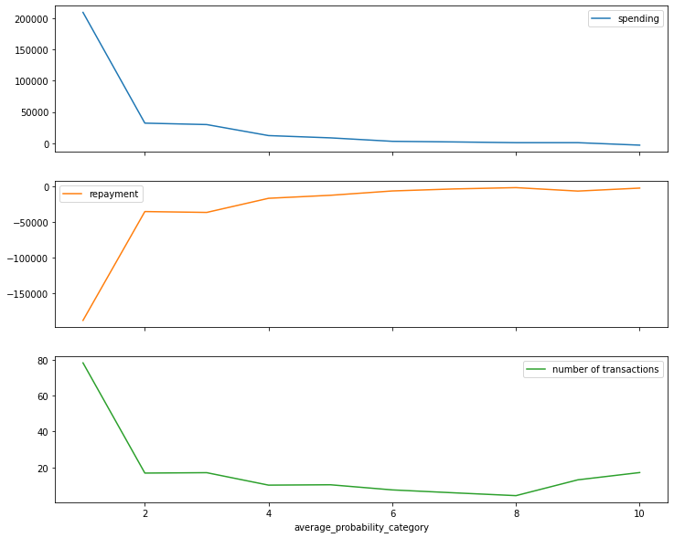
Credit Card Verification
Average value of each category
Credit card records are divided into spending, repayment, interest, and other bill type.
There is obvious trend for each feature. Customers in lower attrition category have higher spending bill, higher repayment bill, and more total transaction records.
Low attrition category
High attrition category
Notes:
需要介绍特征吗

Slide 23
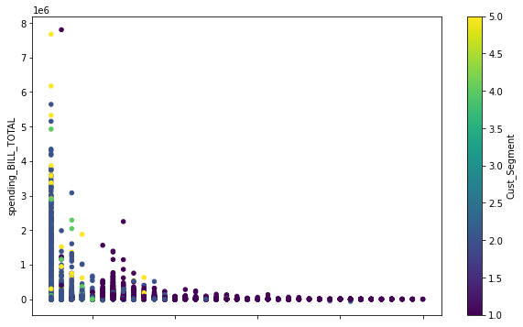
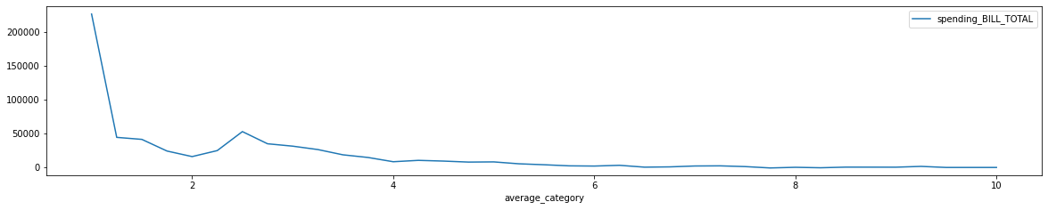
Spending Bill
The scatter plot and line graph show that those with predicted category 1 have higher spending bills.
If the spending bill > 3,000,000, the customer will most likely in a lower attrition category.
1 2 3 4 5 6 7 8 9 10
average _category
Low attrition category
High attrition category
Notes:
需要介绍特征吗

Slide 24
Feature importance
Personal Information
Customer age
Phone banking status
Years After
First Contact
Credit Card
Information
Spending amount
Repayment
amount
Credit card transactions
Product Information
Product Information
Yes
Yes
No
No
Notes:
需要介绍特征吗

Slide 25
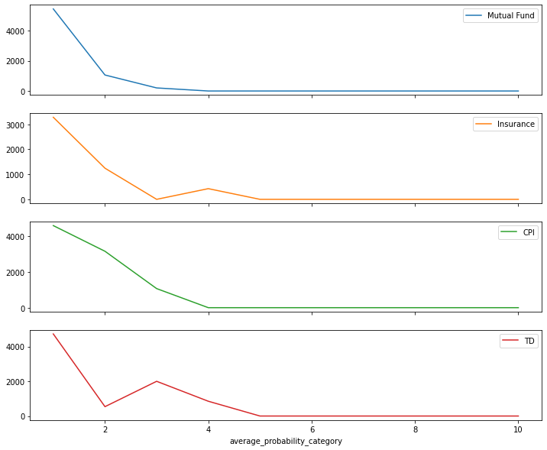
Product Info Verification
The graph shows four type of products: Mutual Fund; Insurance; CPI; TD
The decreasing trends of all four line graph show that customers in lower attrition categories are more likely to buy products.
Average value of each category
Low attrition category
High attrition category
Notes:
需要介绍特征吗

Slide 26
Conclusion
The predicted category are closely related to several features, i.e. phone banking, overseas account, credit card spending amount, whether buy product or not, etc.
We use k-means to define attrition probability into the value of customers
Those customers with high value may have the following characteristics:
More than 10 years account opening experience; have phone banking; have overseas account; have a high spending; buy products, etc.
Next step:
Assign a stage for high value customers

Slide 27
03
Customer
Stage
Segments

Slide 28
weighted RFM-based method
Recency
Frequency
Monetary
Year after first contact until 2018
Number of spending made from 2017/07 to 2018/06
Amount of spending made from 2017/07 to 2018/06
CLV = w_{R} * C_{R} + w_{F} * C_{F} + w_{M} * C_{M}
(w_{R} = 0.731, w_{R} =0.188, w_{R} =0.081)

Slide 29
Six clusters by K-means clustering
Clusters | No. of customers | Recency | Frequency | Monetary | Customer lifetime value
0 | 19610 | 0 | 20.7 | 84561 | 0.00335
1 | 51317 | 1 | 41.14 | 209391 | 0.03823
2 | 6771 | 2.2 | 88.87 | 278411 | 0.08127
3 | 2455 | 1.16 | 481.16 | 424691 | 0.08450
4 | 1471 | 6.13 | 140.11 | 167823 | 0.20960
5 | 548 | 11 | 145.83 | 252847 | 0.36635

Slide 30
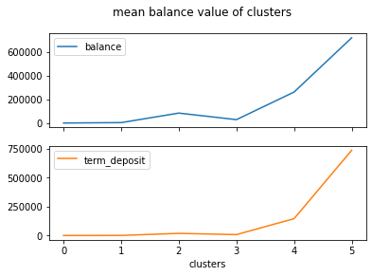
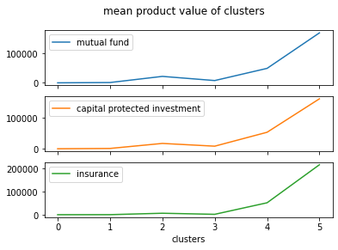
Stage correctness verification
The increasing trends show that customers with higher lifetime value (cluster 4, 5) are more likely to buy products and have deposit.
Notes:
需要介绍特征吗

Slide 31


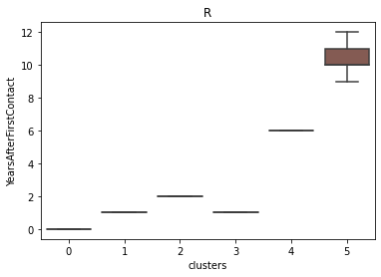
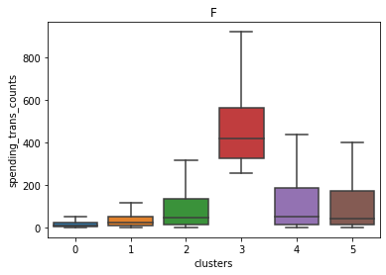
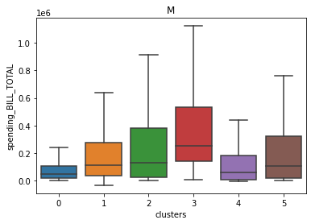
Retention Stage
Honeymoon Stage
Developing Stage
Cluster 4 and 5
Cluster 2 and 3
Cluster 0 and 1

Slide 32
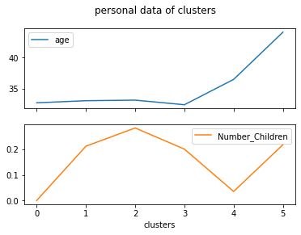
Personal Information
age has an increasing trend
0 ≈ 1 ≈ 2 ≈ 3 < 4 < 5
Number of Children difference between stages.
0 ≈ 4 < 1 ≈ 3 ≈ 5 < 2

Slide 33
04
Conclusion &
Future Work

Slide 34
Conclusion
Though there is no specific evaluation of our segments, the results and trends of the value classification and the stage classification are all reasonable and satisfy our intuition.
There are three stage strategies for the six clusters of our customers:
Developing: advertisements for their purchase preferences
Honeymoon: products recommendation
Retention: vip service

Slide 35
Future Work
Recommendation and Personalized Service
Customer clustered in one stage may have different behaviors
More features from personal information can be taken into consideration
Interactive web
By entering customer ID at the searching box, the page will return his/her profile, product information, credit card transaction, and our recommendations.

Slide 36
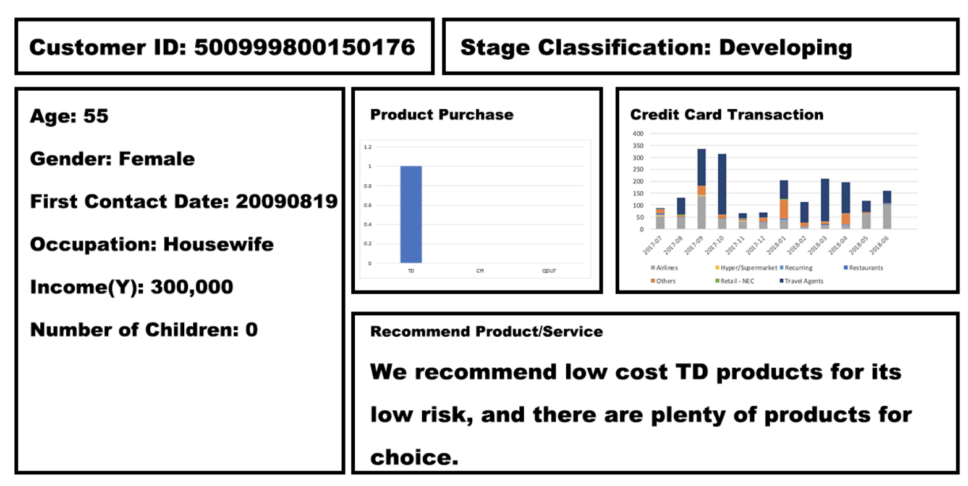

Slide 37
Thanks
Any questions?

Slide 38
Reference
[1] Amaresan, S. Everything you need to know about customer lifecycle management, Jan 2022.
[2] Berry, L. L. Relationship marketing of services: Growing interest, emerg- ing perspectives. Handbook of Relationship Marketing (1983), 149–170. [3] Burton, S. H., Morris, R. G., Giraud-Carrier, C. G., West, J. H., and Thackeray, R. Mining useful association rules from questionnaire data. Intelligent Data Analysis 18, 3 (2014), 479–494. [4] Chao, P. Exploring the nature of the relationships between service quality and customer loyalty: An attribute-level analysis. The Service Industries Journal 28, 1 (2008), 95–116. [5] Djurisic, V., Kascelan, L., Rogic, S., and Melovic, B. Bank crm optimization using predictive classification based on the support vector machine method. Applied Artificial Intelligence 34, 12 (2020), 941–955. [6] F., S. Machine-learning techniques for customer retention: A comparative study. International Journal of Advanced Computer Science and Applica- tions 9, 2 (2018). [7] Farruh, K. Consumer life cycle and profiling: A data mining perspective. Consumer Behavior and Marketing (2020). [8] Gore, M. Customer life cycle management- time and beyond...- exper- tise recognized by clients, analysts like. IOSR Journal of Business and Management 12, 6 (2013), 78–82. [9] Gwinner, K. P., Gremler, D. D., and Bitner, M. J. Relational benefits in services industries: The customer’s perspective. Journal of the Academy of Marketing Science 26, 2 (1998), 101–114. [10] Hsieh, N.-C. An integrated data mining and behavioral scoring model for analyzing bank customers. Expert Systems with Applications 27, 4 (2004), 623–633. [11] Izquierdo, R. 5 stages of the customer life cycle (updated 2022), Jan 2021. [12] Kazemi, A., and Babaei, M. Modelling customer attraction prediction in customer relation management using decision tree: A data mining ap- proach. 37–45.

Slide 39
Reference
[13] Khalilpour Darzi, M. R., Khedmati, M., and Niaki, S. T. Correlation-augmented na ̈ıve bayes (can) algorithm: A novel bayesian method adjusted for direct marketing. Applied Artificial Intelligence (2021), 1–24.
[14] Knott, A., Hayes, A., and Neslin, S. A. Next-product-to-buy models for cross-selling applications. Journal of Interactive Marketing 16, 3 (2002), 59–75.
[15] Kumar, M. R., Venkatesh, J., and Rahman, A. M. Data mining and machine learning in retail business: Developing efficiencies for better customer retention. Journal of Ambient Intelligence and Humanized Computing (2021).
[16] Liu, D.-R., and Shih, Y.-Y. Hybrid approaches to product recommendation based on customer lifetime value and purchase preferences. Journal of Systems and Software 77, 2 (2005), 181–191.
[17] Liu, D.-R., and Shih, Y.-Y. Integrating ahp and data mining for product recommendation based on customer lifetime value. Information amp; Management 42, 3 (2005), 387–400.
[18] Mainardes, E. W., Rosa, C. A., and Nossa, S. N. Omnichannel strategy and customer loyalty in banking. International Journal of Bank Marketing 38, 4 (2020), 799–822.
[19] Mostajer Haghighi, A., Baum, T., and Shafti, F. Dimensions of customer loyalty in hospitality micro-enterprises. The Service Industries Journal 34, 3 (2013), 251–273.
[20] Nui Polatoglu, V., and Ekin, S. An empirical investigation of the turkish consumers’ acceptance of internet banking services. International Journal of Bank Marketing 19, 4 (2001), 156–165.
[21] O’Loughlin, D., and Szmigin, I. Customer relationship typologies and the nature of loyalty in irish retail financial services. Journal of Marketing Management 22, 3-4 (2006), 267–293.
[22] Otim, S., and Grover, V. An empirical study on web-based services and customer loyalty. European Journal of Information Systems 15, 6 (2006), 527–541.
[23] Park, Y.-J., and Chang, K.-N. Individual and group behavior-based customer profile model for personalized product recommendation. Expert Systems with Applications 36, 2 (2009), 1932–1939.

